Slide 1

SUGGESTION MINING USING ATTENTION NETWORKS Final PRC (23-05-2020)
Under the Guidance of
Mr L. Naveen Kumar:
Assistant Professor
Team:12
16WH1A1216 – E. Meghana
16WH1A1229 – K. Samhitha
16WH1A1247 – M. Haritha

Slide 2
Contents
Introduction
Problem Definition
Literature Survey
Existing System and Proposed System
Architecture Diagram
Module(s)
Model Summary
Input and Output
Plan of Action
References

Slide 3
Introduction
Products and services are heavily discussed on social media.
Reviews may contain tips/ suggestions/ advices.
Suggestion containing reviews are of great help to the product owners and peer customers.

Slide 4
Problem Definition
Identifying and highlighting suggestion expressing sentences in the given opinionated text(review) using attention based networks.

Slide 5
Literature Survey
Hierarchical Attention Networks for Document Classification by Zichao Yang, Diyi Yang, Chris Dyer, Xiaodong He, Alex Smola, Eduard Hovy.
Convolutional Neural Networks for Sentence Classification by Yoon Kim
Machine Translation Using Deep Learning: An Overview by Shashi Pal Singh, Ajai Kumar, Hemant Darbari, Lenali Singh, Anshika Rastogi and Shikha Jain.
Machine Translation Using Deep Learning : A Survey by Janhavi R. Chaudhary and Ankit C. Patel

Slide 6
Existing System & Proposed System
Existing System:
Several baseline methods, including traditional approaches such as linear
methods, SVMs and paragraph embedding using neural networks, CNN, LSTMs, were used.
Proposed System:
Attention mechanism is applied to visualize the attention over informative words.

Slide 7
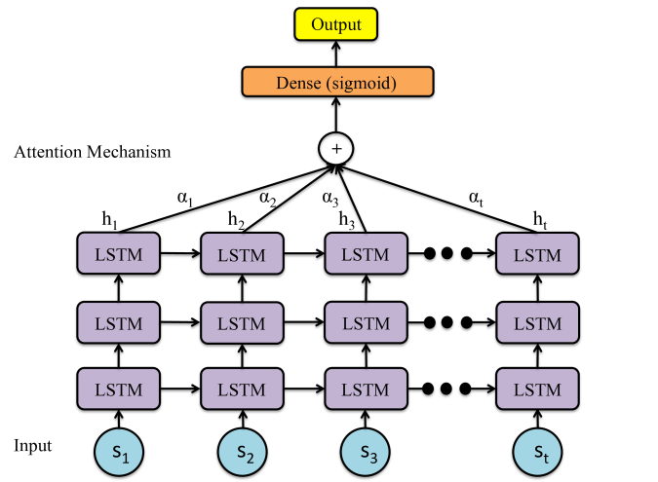
Architecture Diagram

Slide 8
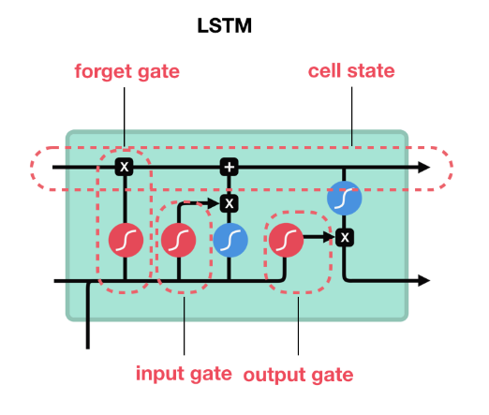
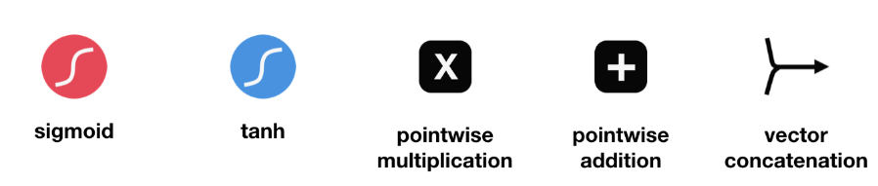
Architecture Diagram
LSTM Architecture

Slide 9
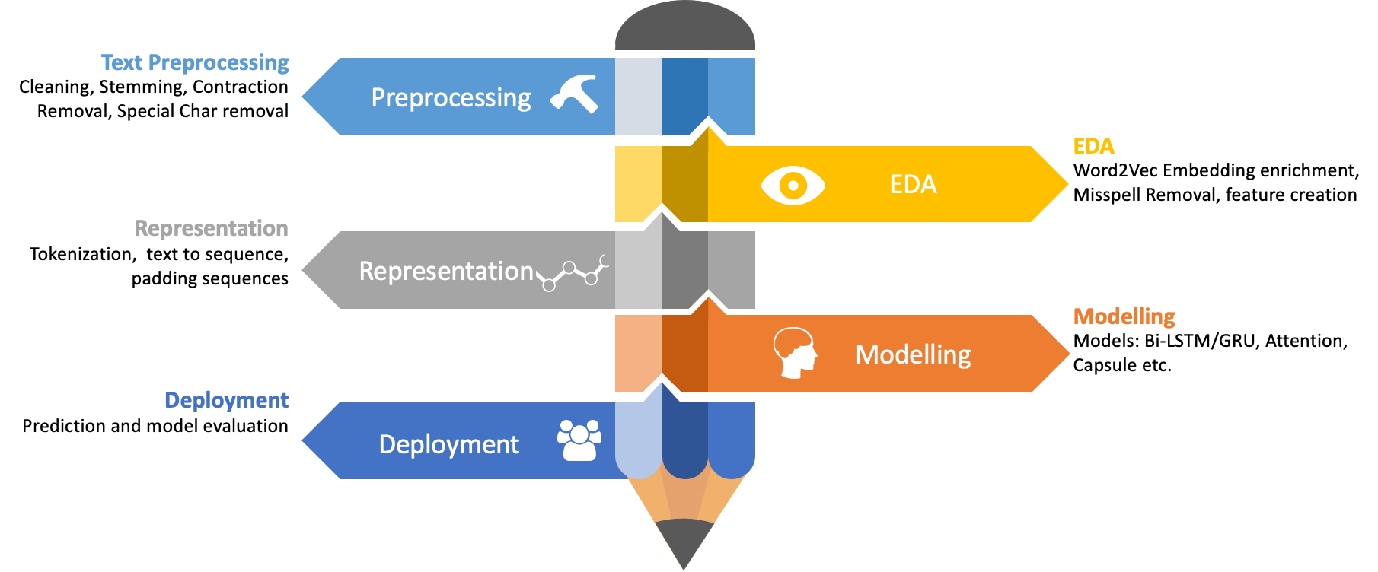
Modules

Slide 10
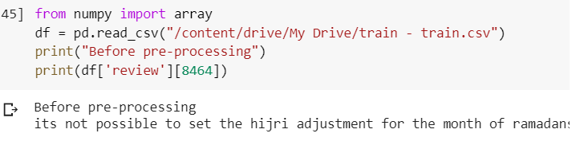
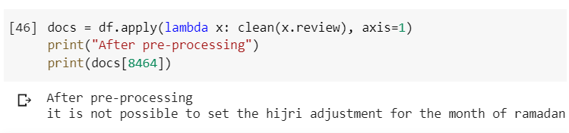
Preprocessing
Before Preprocessing
After Preprocessing

Slide 11
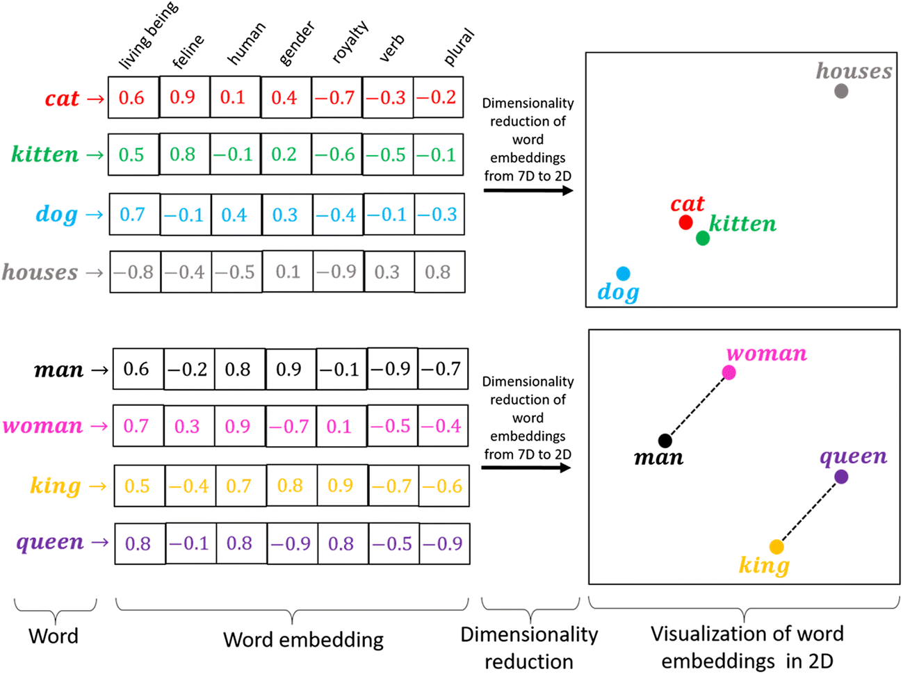
Embeddings
Word Embedding: Word embeddings are a type of word representation that allows words with similar meaning to have a similar representation
Word embedding methods learn a real-valued vector representation for a predefined fixed sized vocabulary from a corpus of text.
Popular Word Enbeddings are
Glove (2014)
Word2Vec (2013)
FastText (2016)
GLOVE stands for GLObal VEctors for word representation.
It is an unsupervised learning algorithm developed by Stanford for generating word embeddings by aggregating global word-word co-occurrence matrix from a corpus.
It has 3 kinds of dimensions 50, 100, 200, and 300

Slide 12
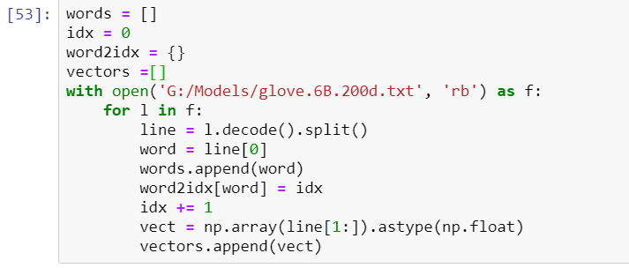
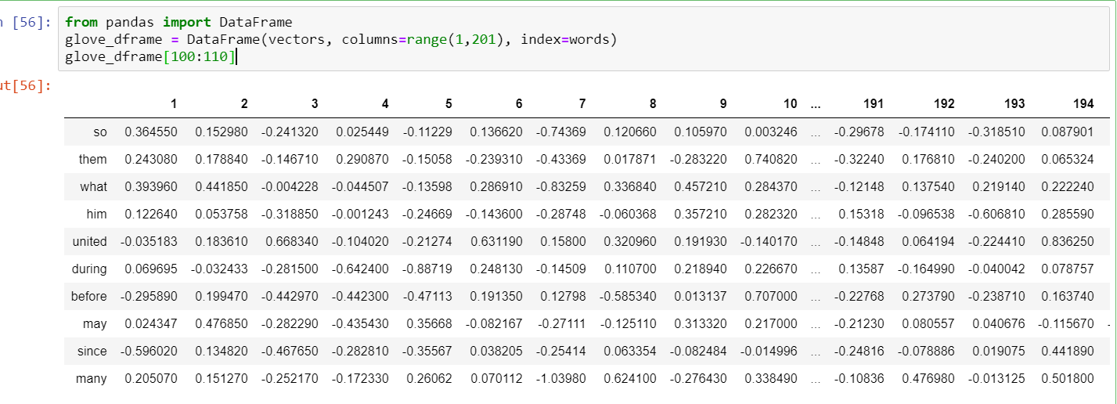
Glove Vectors

Slide 13

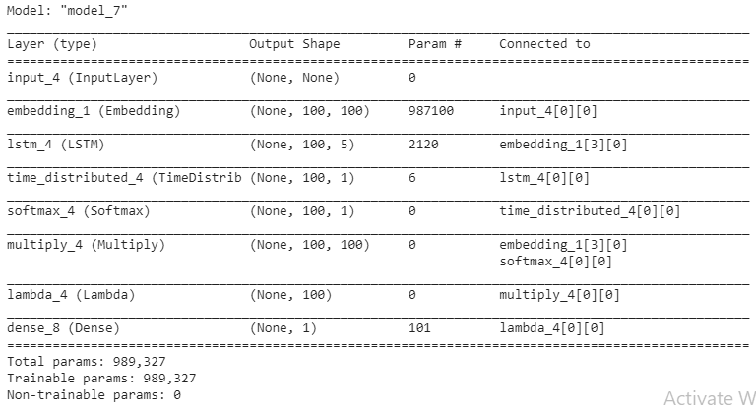
Model using
LSTM

Slide 14
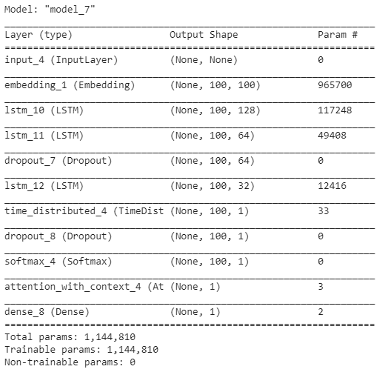
Model Summary
Model using Attention
and LSTM with
Time Distributed Layer

Slide 15
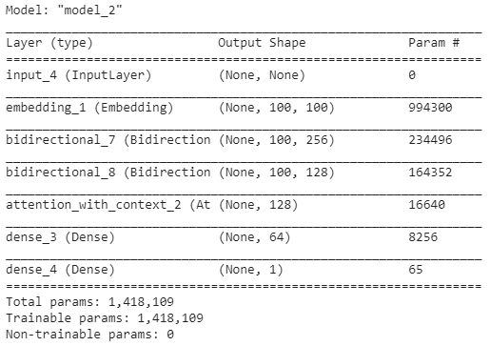
Model Summary
Model using
Bi-Directional LSTM with Attention layer

Slide 16
Input
Training dataset
https://docs.google.com/spreadsheets/d/1zAZ9zDmz34XQRHSv6zWYUZAZwLgxN6mLcXAKCD5M3CM/edit#gid=1719501802
Testing dataset
https://docs.google.com/spreadsheets/d/11PbaH67ihp3YyXkX8WxITM7EcCsx5zgc04eVabWL5Qo/edit#gid=1120463267

Slide 17
Output
1. Using LSTM Model
2. Using Attention and LSTM with Time Distributed Layer Model
3. Using Bi-Directional LSTM Model with Attention layer
When we use 7 epochs:

Slide 18
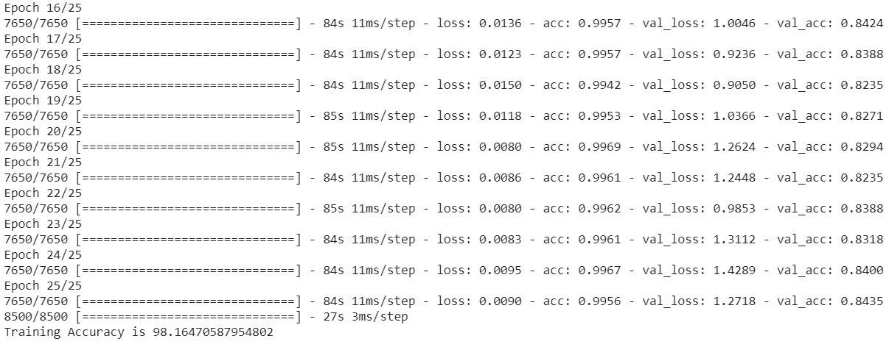
Output
When we use 25 Epochs:

Slide 19
Output
SNo. | Model | Accuracy | Precision | Recall | F1 Score
1 | LSTM + Time Distributed Layer | 75 | 0.568095 | 0.753721 | 0.647874
2 | LSTM + Attention + Time Distributed Layer | 75 | 0.814374 | 0.753721 | 0.647874
3 | Bi-LSTM + Attention | 87 | 0.845009 | 0.808235 | 0.722521
Model Comparison Table

Slide 20
Comparison Graph

Slide 21
Action Plan
Module Information | Status | Time required to Complete
Literature Survey | Completed | 1 Week
Requirement Analysis | Completed | 1 Week
Design | Completed | 2 Weeks
Implementation | Completed | 2 Weeks
Documentation | Completed | 2 Weeks
Final Submission | To be done

Slide 22
References
Hierarchical Attention Networks for Document Classification Zichao Yang, Diyi Yang, Chris Dyer, Xiaodong He, Alex Smola, Eduard Hovy. https://www.cs.cmu.edu/~./hovy/papers/16HLT-hierarchical-attention-networks.pdf
Negi, Sapna, Tobias Daudert, and Paul Buitelaar. "Semeval-2019 task 9: Suggestion mining from online reviews and forums." Proceedings of the 13th International Workshop on Semantic Evaluation. 2019.
Natural Language Processing https://mlwhiz.com/nlpseries/
Attention Layer https://gist.github.com/cbaziotis/7ef97ccf71cbc14366835198c09809d2

Slide 23


